Slide 1


UNIVERSITY INSTITUTE OF ENGINEERING
COMPUTER SCIENCE ENGINEERING
Bachelor of Engineering (Computer Science & Engineering)
Subject Name: STATISTICAL METHODS USING R
Subject Code: 20SMT-460

Slide 2
Introduction to R

Slide 3
What is R?
R is a popular open-source programming language for statistical computing and data analysis. R typically includes a command-line interface. It is an interpreted computer programming language developed by Ross Ihaka and Robert Gentleman at the University of Auckland in New Zealand. R supports not only branching and looping but also modular programming via functions. To boost efficiency, R can be integrated with procedures written in C, C++, .Net, Python, and FORTRAN.

Slide 4
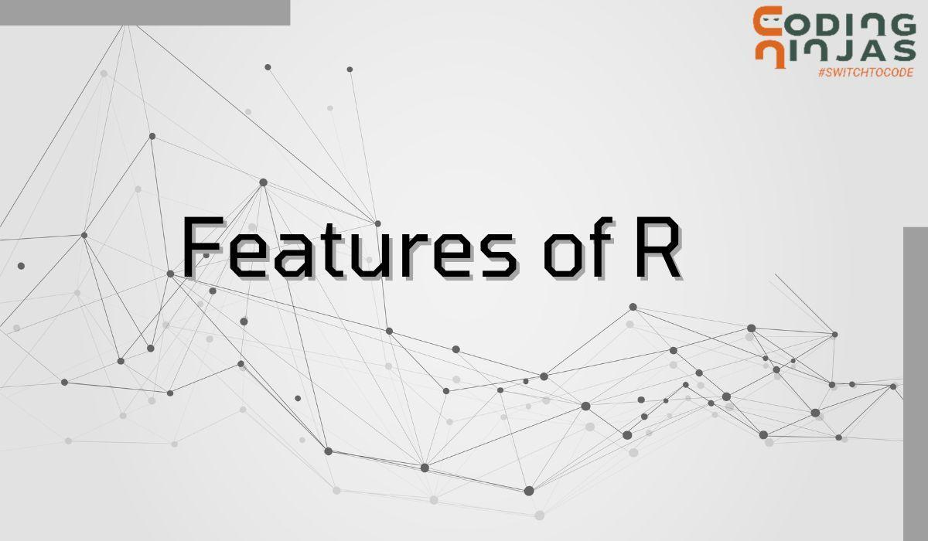

Slide 5
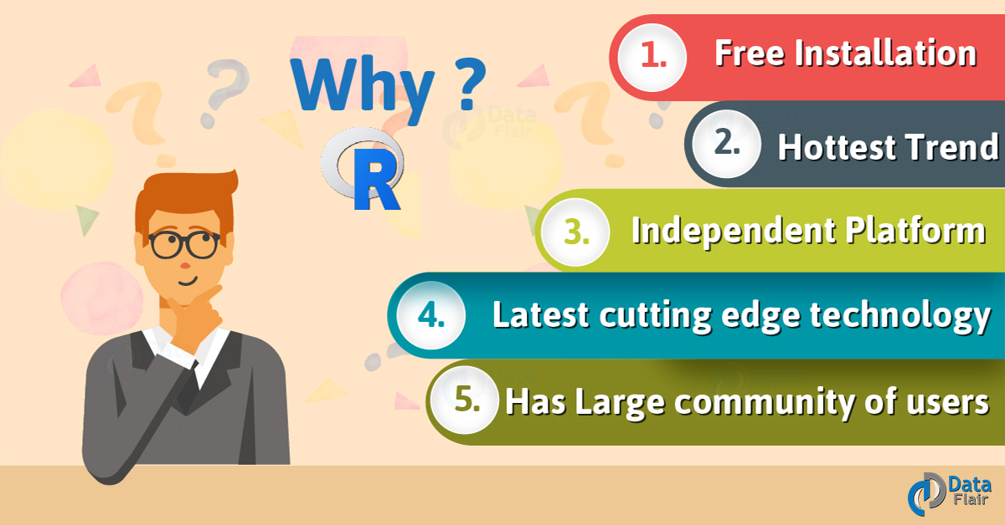

Slide 6
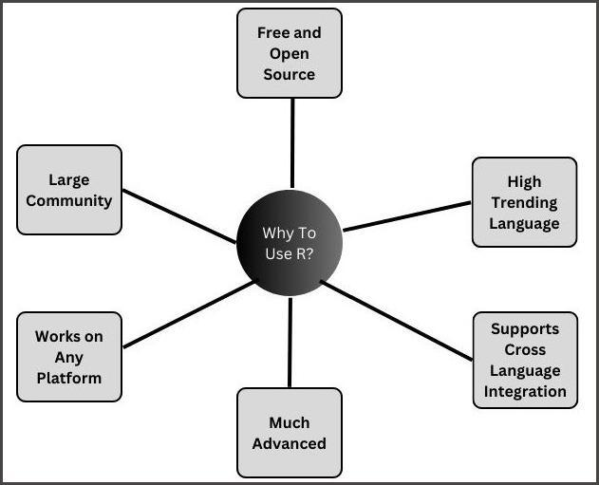

Slide 7
Applications of R
Some of the applications of R are given below:
R is used for Data Science. It offers us a wide range of statistics-related libraries. Additionally, it offers a setting for statistical computation and design.
Many quantitative analysts utilize R as a programming language. As a result, it aids in data import and cleansing.
In environmental science, R is used to analyze and simulate environmental data, climate data, and ecological data.
The most common language is R. It is used by a large number of data analysts and research programmers. As a result, it is employed as a fundamental financial instrument.

Slide 8
https://youtu.be/riONFzJdXcs?feature=shared

